Slide 1

WORKSHOP ON STATISTICS & PROBABILITIES 15-16 OCT 2016
INTRODUCTION TO

Slide 2
AGENDA
History and evolution of R
Principle and software paradigm
Description of R interface
Advantages of R
Drawbacks of R
So why use R?
References for learning R

Slide 3
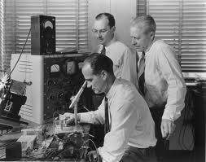

HISTORY AND EVOLUTION OF R
Origin in the Bell Labs in the 1970’s

Slide 4


HISTORY AND EVOLUTION OF R
R has developed from the S language
S Version 1
S Version 2
S Version 3
S Version 4
Developed 30 years ago for research
applied to the high-tech industry

Slide 5
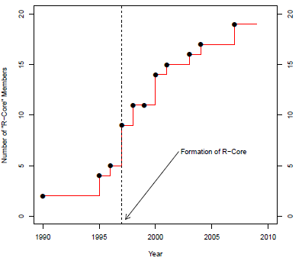
HISTORY AND EVOLUTION OF R
The regular development of R
1990’s: R developed concurrently with S
1993: R made public
Acceleration of R development
R-Help and R-Devl mailing-lists
Creation of the R Core Group
Source: R Journal Vol 1/2

Slide 6
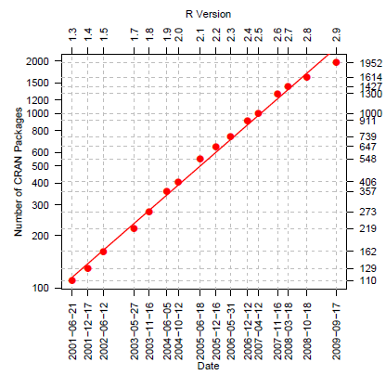
HISTORY AND EVOLUTION OF R
Growing number of packages
2001: ~100 packages
2009: Over 6760 packages
2000: R version 1.0.1
Today: R version 3.3.1 (Bug in your hair)
Source: R Journal Vol 1/2

Slide 7
HISTORY AND EVOLUTION OF R
Explosion of R popularity in the last decade
Object-oriented, growing user base, scripting features
Free and open-source
Irrational reasons: R seen as « cool »

Slide 8
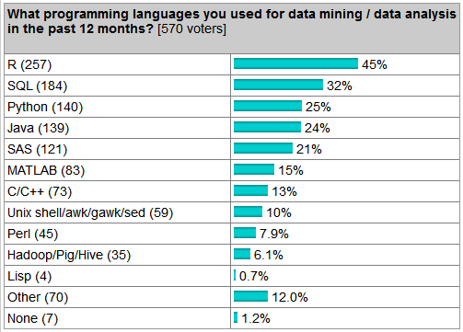
HISTORY AND EVOLUTION OF R
Popularity amongst programming languages
KD Nuggets 2015 survey

Slide 9
HISTORY AND EVOLUTION OF R
Number of Blogs
Software | Number of Blogs
R | 365
SAS | 40
Stata | 8
Others | 0-3
Data as on Mar 2015

Slide 10
AGENDA
History and evolution of R
Description of R interface
Advantages of R
Drawbacks of R
So why using R?
References for learning R

Slide 11
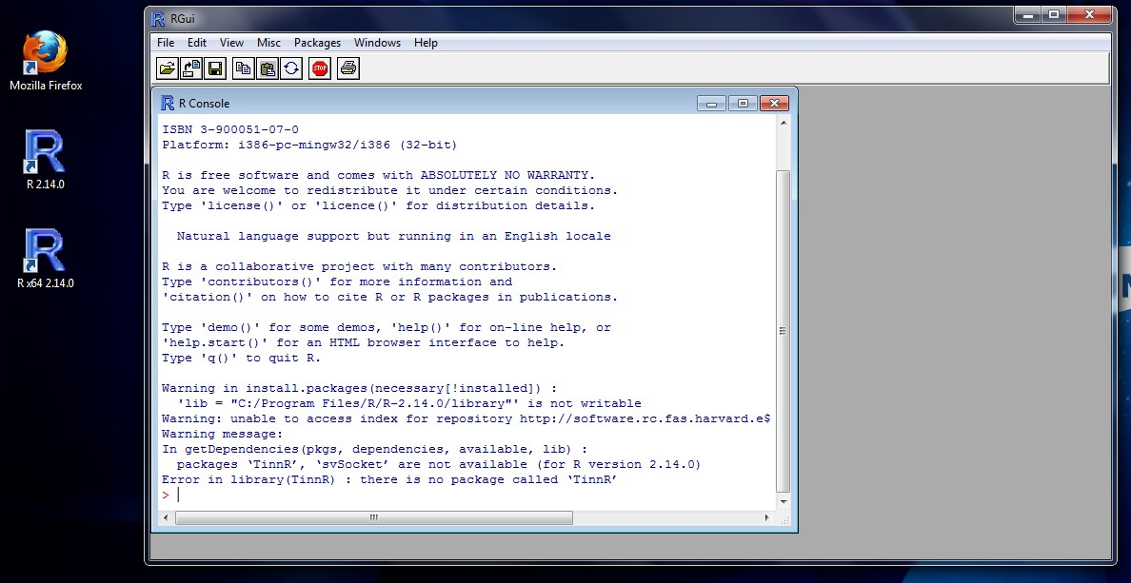
DESCRIPTION OF R INTERFACE
R console
RGui: R basic
interface
R desktop shortcut
R command line (space to write instructions)

Slide 12
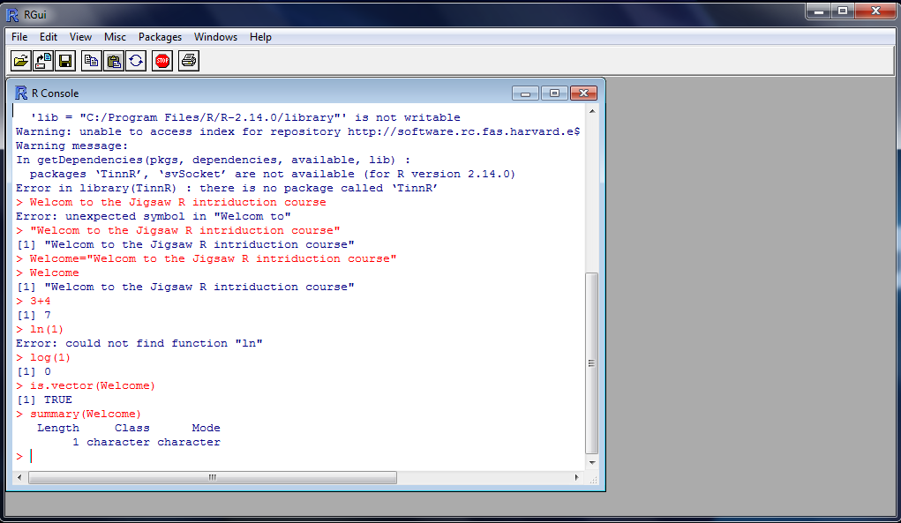
DESCRIPTION OF R INTERFACE
Using the command line in R console
First false sentence followed by R’s error message
Second correct sentence
Declaration and printing of the sentence as a R object
Simple math computations
Basic information about the R object containing the sentence

Slide 13
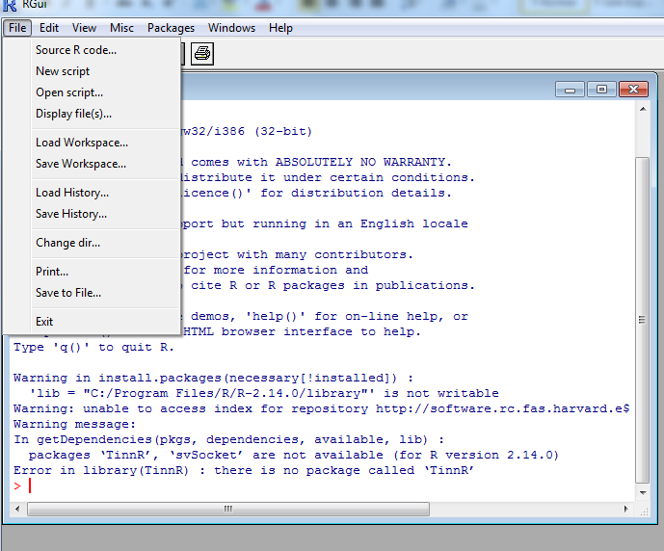
DESCRIPTION OF R INTERFACE
RGui menu: File tab
File tab: Usual basic and general operations

Slide 14
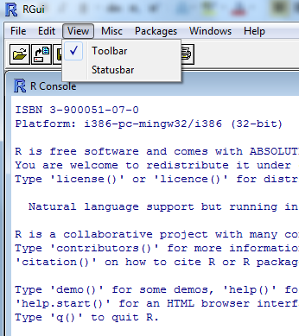
DESCRIPTION OF R INTERFACE
RGui menu: View tab
View tab: viewing Toolbar and/or Status bar

Slide 15
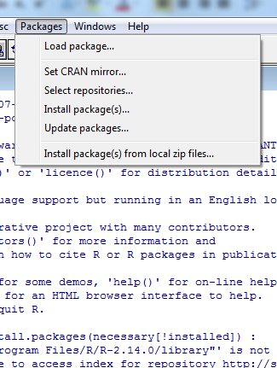
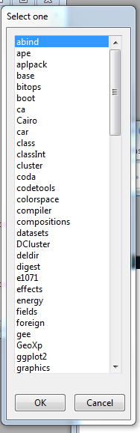
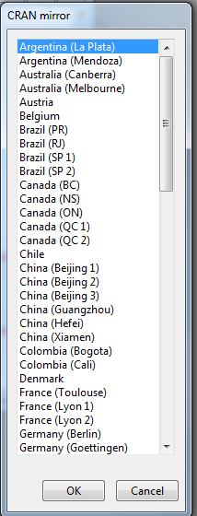
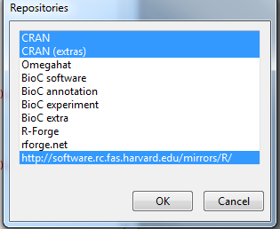
DESCRIPTION OF R INTERFACE
RGui menu: Packages tabs
Packages tab: adding functions to R foundation

Slide 16
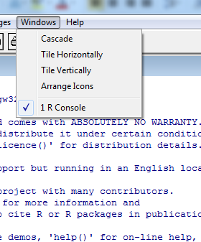
DESCRIPTION OF R INTERFACE
RGui menu: Windows tab
Windows tab: usual options to arrange the tiles

Slide 17
AGENDA
History and evolution of R
Principle and software paradigm
Description of R interface
Advantages of R
Drawbacks of R
So why using R?
References for learning R

Slide 18
ADVANTAGES OF R
R is free
Software | Academics | Demo | Commercial (basic) | Commercial (full)
R | Free | Free | Free | Free
SAS | Free to $100s | Not available | $1 000s | $10 000s
Statistica | $100s | 30 days limit | ~$1 000 | $10 000
Excel (Microsoft) | Free to $10s | Limited | ~$100 | $100s
SPSS (IBM) | $100s | 14 days limit | ~$2 000 | $1 000s

Slide 19
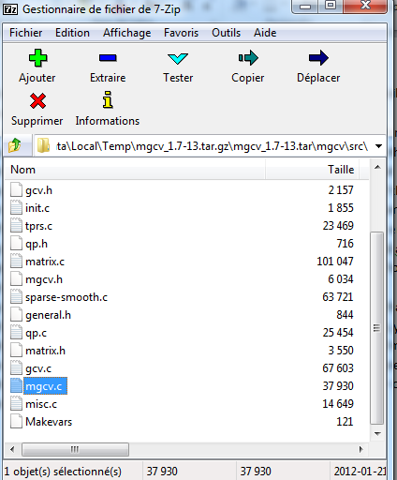
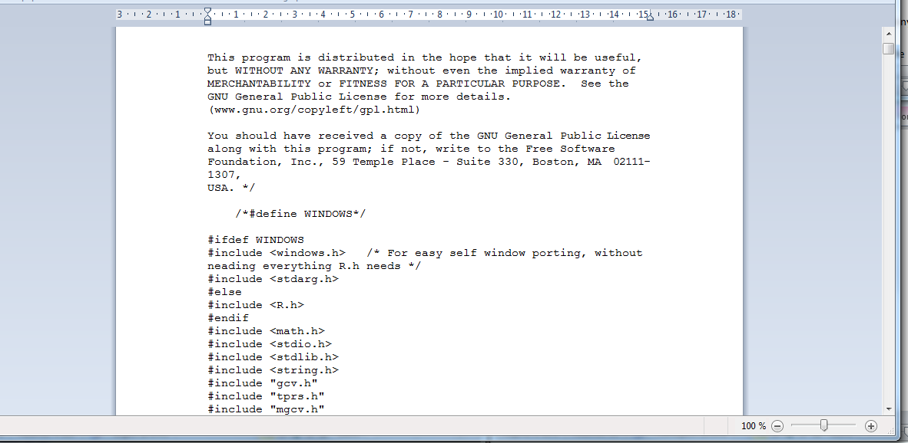
ADVANTAGES OF R
Interface with other languages and scripting capabilities
Interfaces with virtually any other programming language
Fortran, C, C++, Python…
Tailor or rewrite your old codes in R
R as a scripting language
R scripts can launch or be launched by other languages
« mgcv.c » file in the
« mgcv » package coded in typical C programming language
Screenshot of the file « mgcv.c » of the « mgcv » package open in WordPad

Slide 20

ADVANTAGES OF R
R visualization capabilities

Slide 21
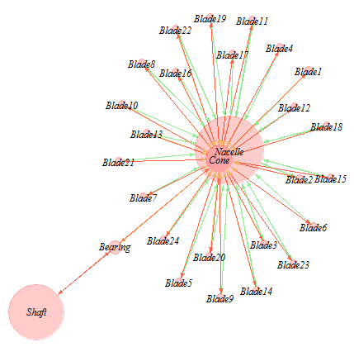
ADVANTAGES OF R
R visualization capabilities

Slide 22
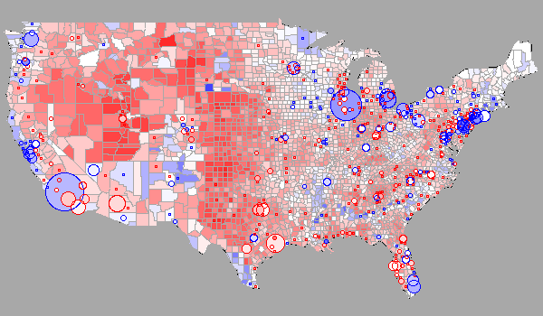
ADVANTAGES OF R
R visualization capabilities

Slide 23

ADVANTAGES OF R
R role in academia
R ~ tool used by the finest researchers
Top-notch analytics capabilities
Screenshot of a user’s Facebook map . Source: Paul Butler/Facebook, DG Rossiter, spatialanalysis.co.uk

Slide 24
ADVANTAGES OF R
To summarize
Free open source philosophy
R websites with many examples
Free books
Free online open courses
Twitter accounts
Online help and discussion
Mailing-lists
Very active and diverse forums
Communities of developers and helpers

Slide 25
AGENDA
History and evolution of R
Principle and software paradigm
Description of R interface
Advantages of R
Drawbacks of R
So why using R?
References for learning R

Slide 26
DRAWBACKS OF R
Average memory performance
Poor management of large datasets
Avoid imbricated loops
Prefer R advanced language for data structure
Complicated structure of packages in R
Dozen of packages
To be loaded every time in memory
R packages to better manage memory
Rhadoop (inspiration from Google)
Bigmemory

Slide 27
DRAWBACKS OF R
Average computing performance
No default parallel execution
R packages to use several cores
Top skills needed for high performance computing
A high-level programming language
Abstract and modern (Python…)
More productive coding
But further from « machine language »…
… meaning 100 times slower than C

Slide 28
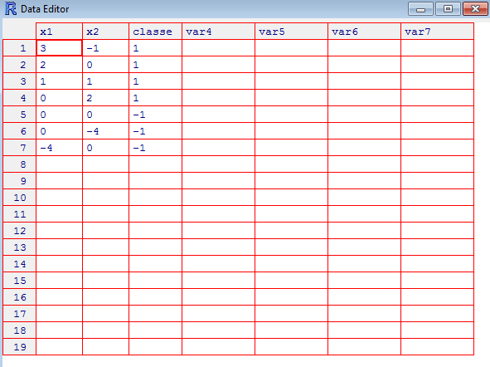
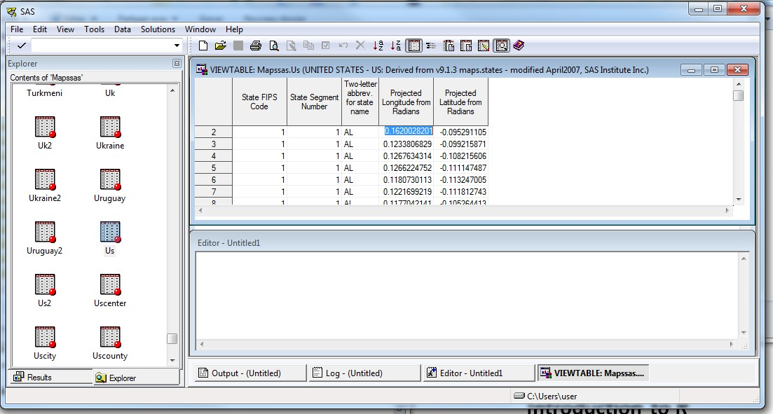
DRAWBACKS OF R
Difficult data visualization and management
Difficult to inspect data sets
Screenshot of the R data editor and « Viewtable » tab in SAS 9.3

Slide 29

DRAWBACKS OF R
Difficult architecture management
Problems for large organizations
R made of several thousands independent packages
No deployment plan for complex organizations
No installation support
Lack of code accountability
Thousands of individual independent R developers
Nobody responsible for the quality of the code
Potentially high hidden costs with R
Total cost may favour commercial solutions for complex computations made in large
corporations

Slide 30


DRAWBACKS OF R
Relatively difficult to learn
Steep learning curve
R code far from undergrad computer science courses
Very complex data structures (useful if mastered)
Is R’s syntax not logical?
Still, not more difficult to learn than SAS
▪
▪
Both SAS and R more abstract than basic programming languages (Fortran, C…) Difficult to learn = more rewarding professionally!!

Slide 31
AGENDA
History and evolution of R
Principle and software paradigm
Description of R interface
Advantages of R
Drawbacks of R
So why use R?
References for learning R

Slide 32
SO WHY LEARN R?
More positive than negative points
No language is perfect!!
Contradictory objectives to meet
Strengths and weaknesses of each language
Effect of legacy and the culture of the organization
Use existing solutions (system architecture, BA tools…)
Habits in business analytics
Different needs imply different tools
Large corporations + defined procedures → SAS-like
Less financial resources + quick proof of concept → R

Slide 33
SO WHY LEARN R?
Very appealing solution
Overall
Corporate
Consultants
Academics
NGO/Gov't
R
SAS
IBM SPSS STATISTICA
Own code
Popularity of business analytics software (green = very popular, red = unpopular). Source: Rexer Analytics

Slide 34
AGENDA
History and evolution of R
Principle and software paradigm
Description of R interface
Advantages of R
Drawbacks of R
So why using R?
References for learning R

Slide 35
REFERENCES FOR LEARNING R
Books
Many books available: choose the one that fits you!
Style, pedagogy, theory vs practice
Browse several books at local library or store
Springer’s UseR! Series (http://www.springer.com/series/6991)
Recent, concise, good quality, affordable, diverse
Pure rookies: « A beginners’ guide to R », « R by example »
One step forward: « Business analytics for managers »
Intensive Excel users: « R through Excel »
O’Reilly R series (for programmers)
« R cookbook », « R in a nuttshell »

Slide 36
REFERENCES FOR LEARNING R
Websites
R official websites
The R project for statistical computing (www.r-project.org )
Mailing lists (« R-help », Special Interest Groups) and R journal
Official (austere) manuals (« An introduction to R »)
Other websites
UCLA online R resources http://www.ats.ucla.edu/stat/r/)
R blogs aggregator (www.r-bloggers.com)
Social networks: LinkedIn groups (The R project for statistical computing), Twitter accounts (@RevolutionR, @inside_R), jobboards (Analytical Bridge…)

